Slide 1
Simple Mail Transfer Protocol (SMTP)

Slide 2
SMTP
SMTP stands for Simple Mail Transfer Protocol.
When an e-mail is sent from the sender to receiver, in most cases this involves, the sender machine sends the email to local SMTP sever, which in then sends mail to recipients local SMTP sever, and finally to recipients local machine.

Slide 3
SMTP
Actual mail transfer requires MTA (Message transfer agents).
Sender MTA and Receiver MTA.

Slide 4
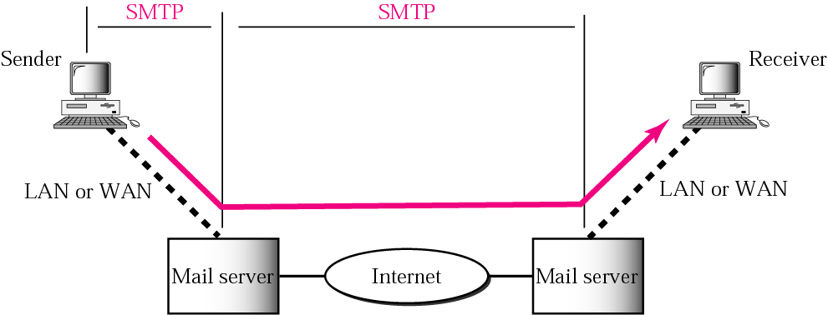

Slide 5
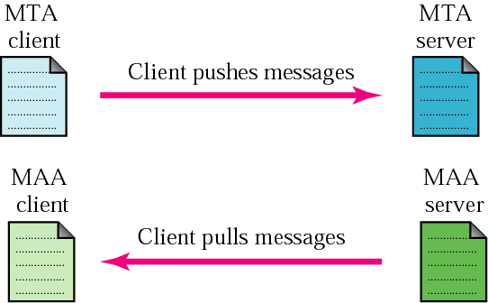
Message transfer…
SMTP is a push protocol

Slide 6
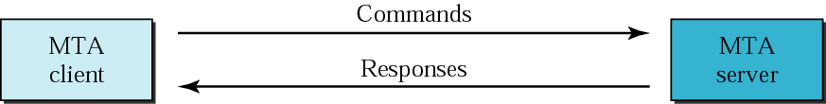
How SMTP works?

Slide 7
Commands of SMTP
HELO : Request to initiate SMTP session
MAIL FROM : Sender’s E-Mail address
RCPT TO : Receiver’s E-Mail address
DATA : Body of message
QUIT : Terminates SMTP connection
RSET : Aborts mail transaction
VRFY : Asks receiver to verify the validity of the mailbox
EXPN : Asks receiver to identify mailing list
HELP : Causes receiver to send help information
NOOP : Forces server to verify the communication with SMTP
receiver

Slide 8
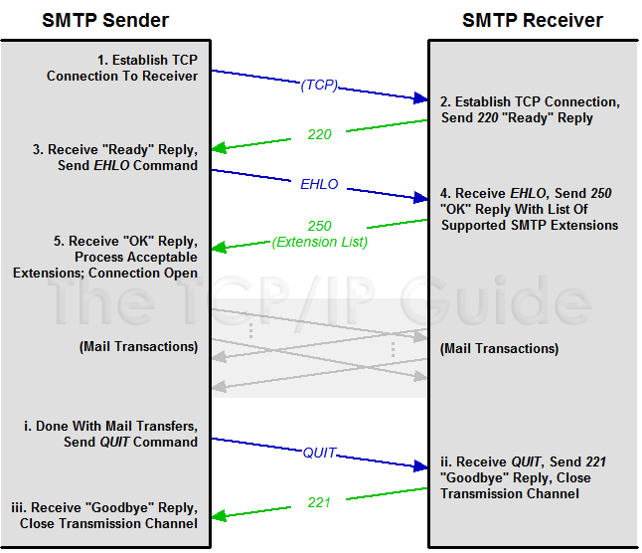
Session Establishment and Termination

Slide 9
SMTP Mail Transaction Process
1. Transaction Initiation and Sender Identification
S: HELO sjsu.edu
R: 250 Hello sjsu.edu S: MAIL FROM:<cooldd10@yahoo.com> R: 250 Ok
2. Recipient Identification
S: RCPT TO:<jainip_1983@gmail.com> R: 250 Ok
3. Mail Transfer
S: DATA R: 354 End data with <CR><LF>.<CR><LF> S: <The message data>
S:. R: 250 Ok, message accepted for delivery: queued as 12345 S: QUIT R: 221 Bye

Slide 10
File Transfer Protocol
File Transfer Protocol (FTP) is the standard mechanism provided by TCP/IP for copying a file from one host to another.
FTP uses the services of TCP. It needs two TCP connections.
The well-known port 21 is used for the control connection and the well-known port 20 for the data connection
Establishes two connections
Data Transfer
Control Information Transfer

Slide 11
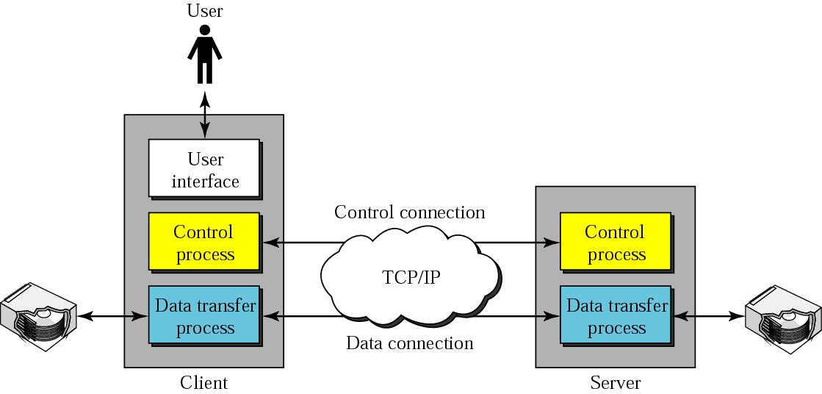
FTP Model

Slide 12
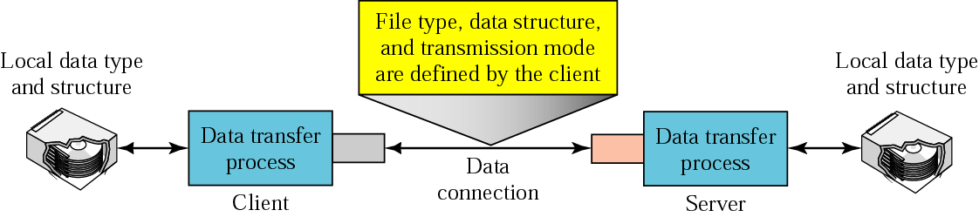
Using the data connection

Slide 13
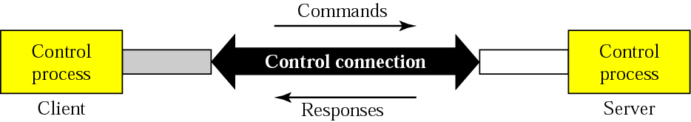
Command processing

Slide 14
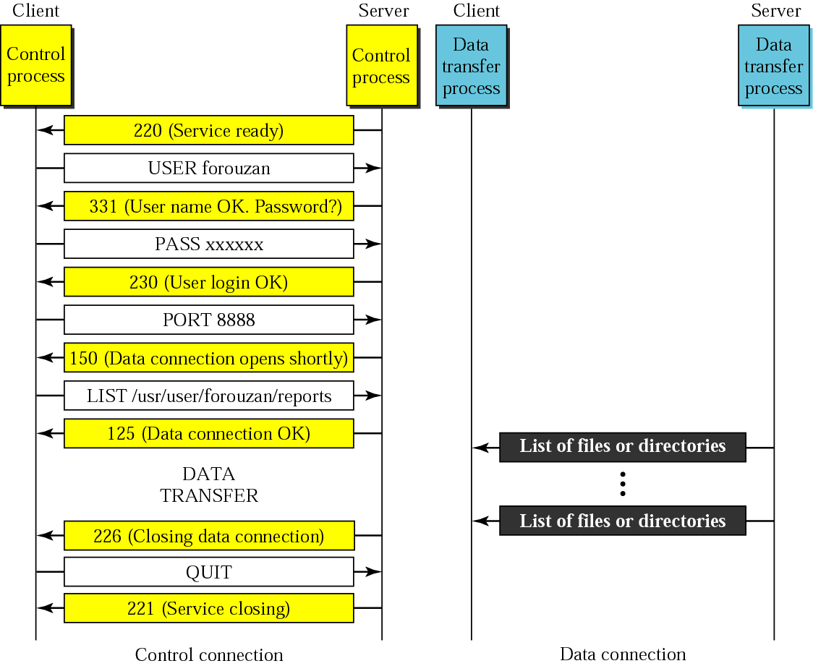

Slide 15
Domain Name Server (DNS)
NEED FOR DNS NEED FOR DNS
To identify an entity, TCP/IP protocols use the IP address, which uniquely identifies the connection of a host to the Internet. However, people prefer to use names instead of numeric addresses. Therefore, we need a system that can map a name to an address or an address to a name.
The names must be unique because the addresses are unique

Slide 16
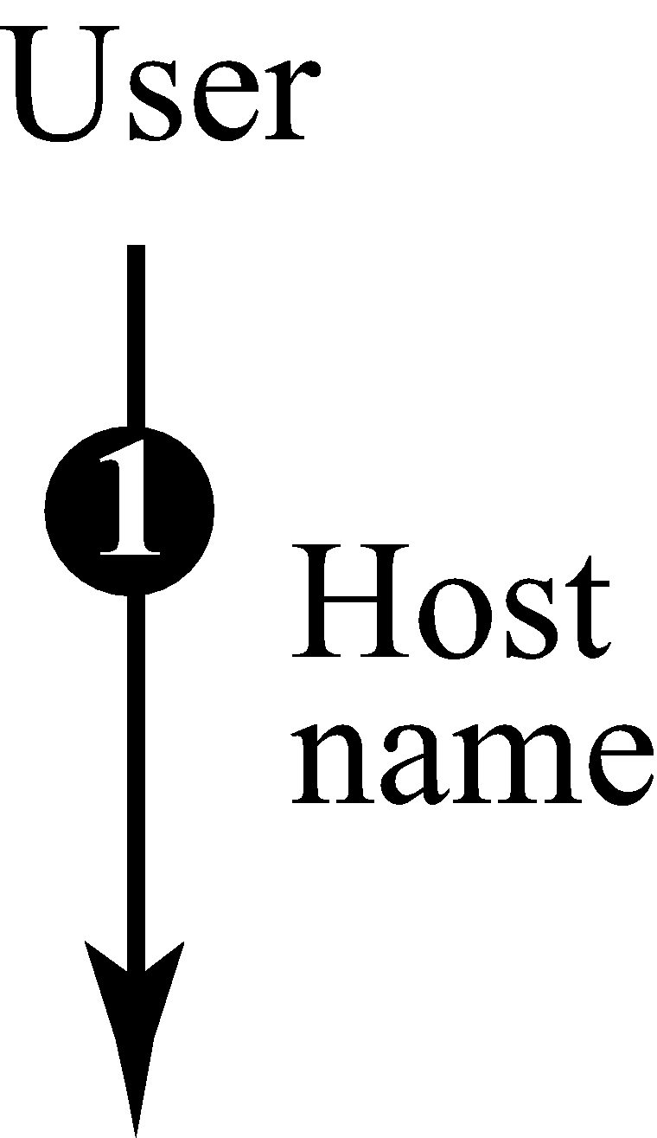
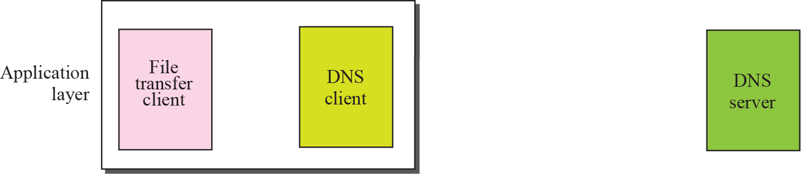
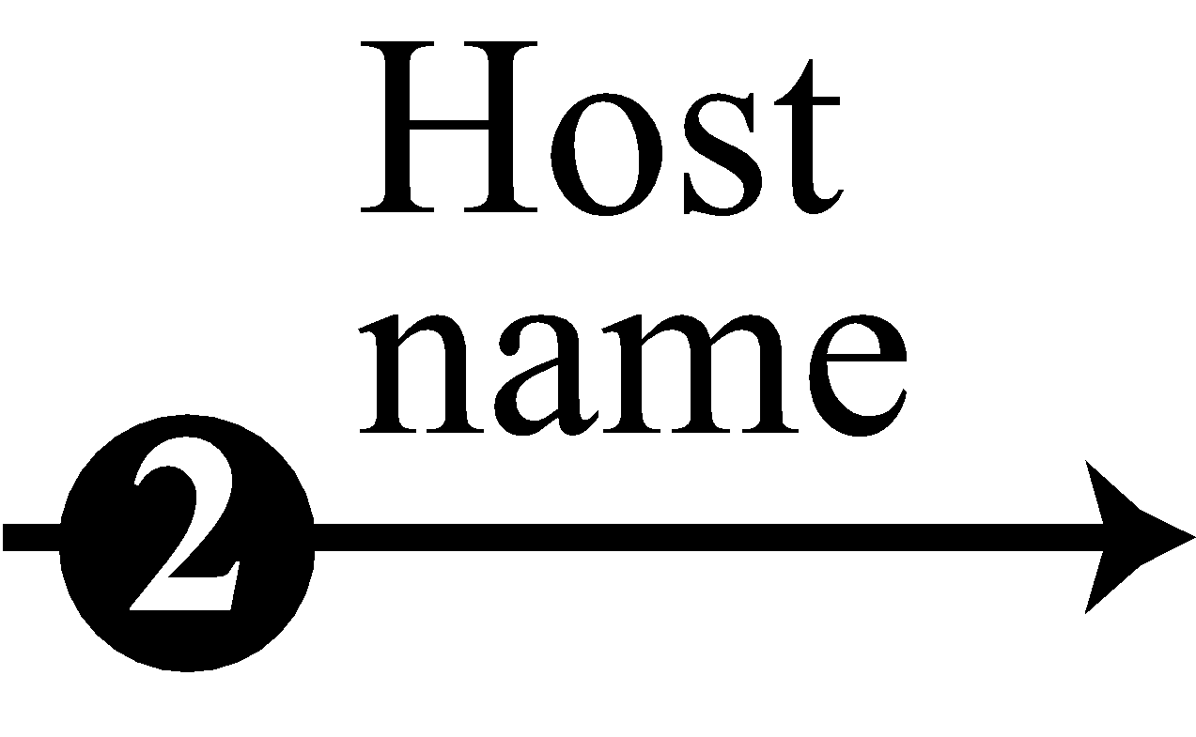
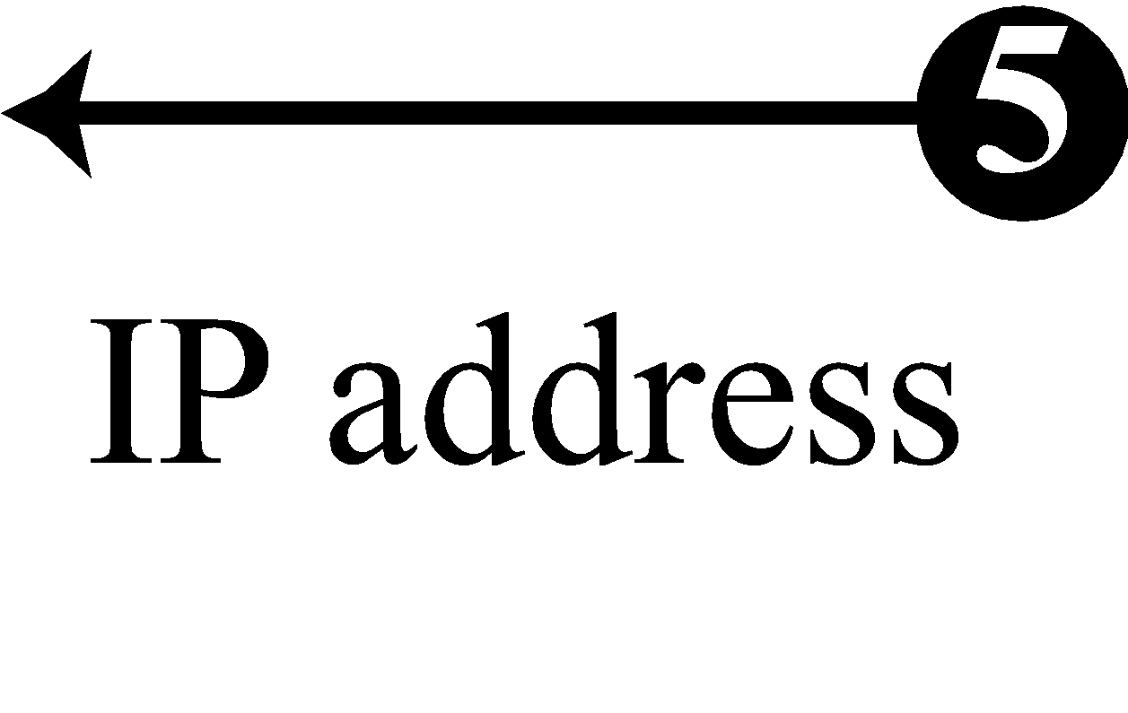
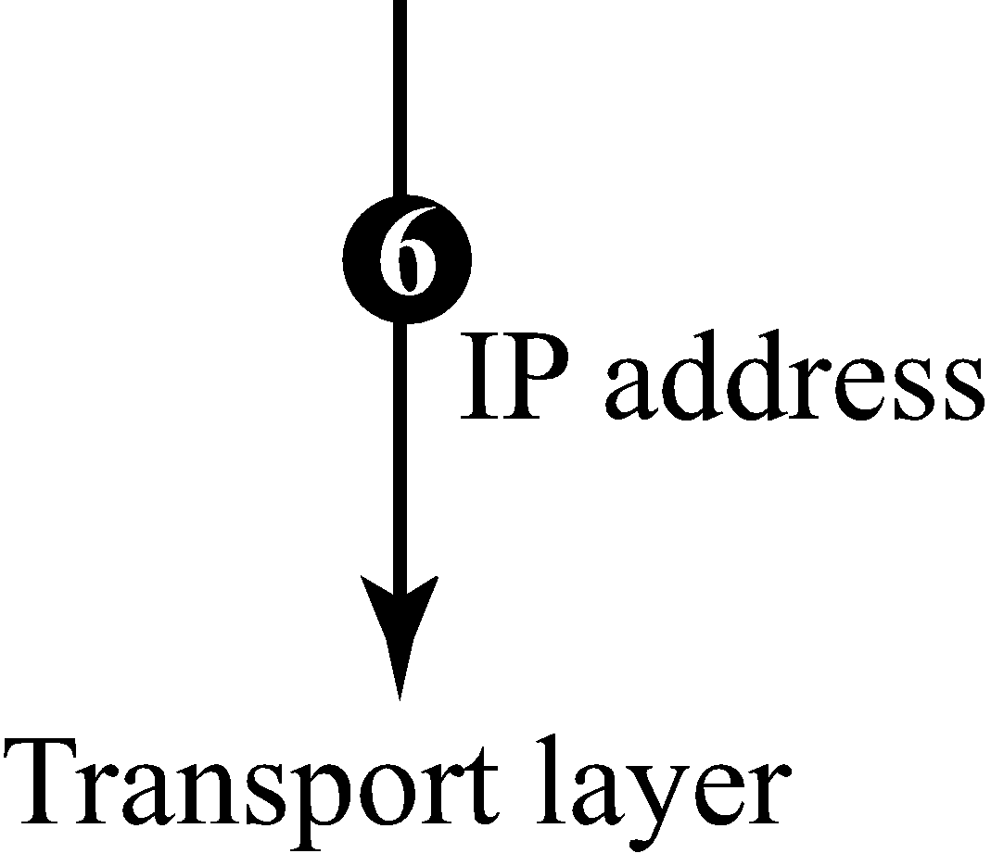
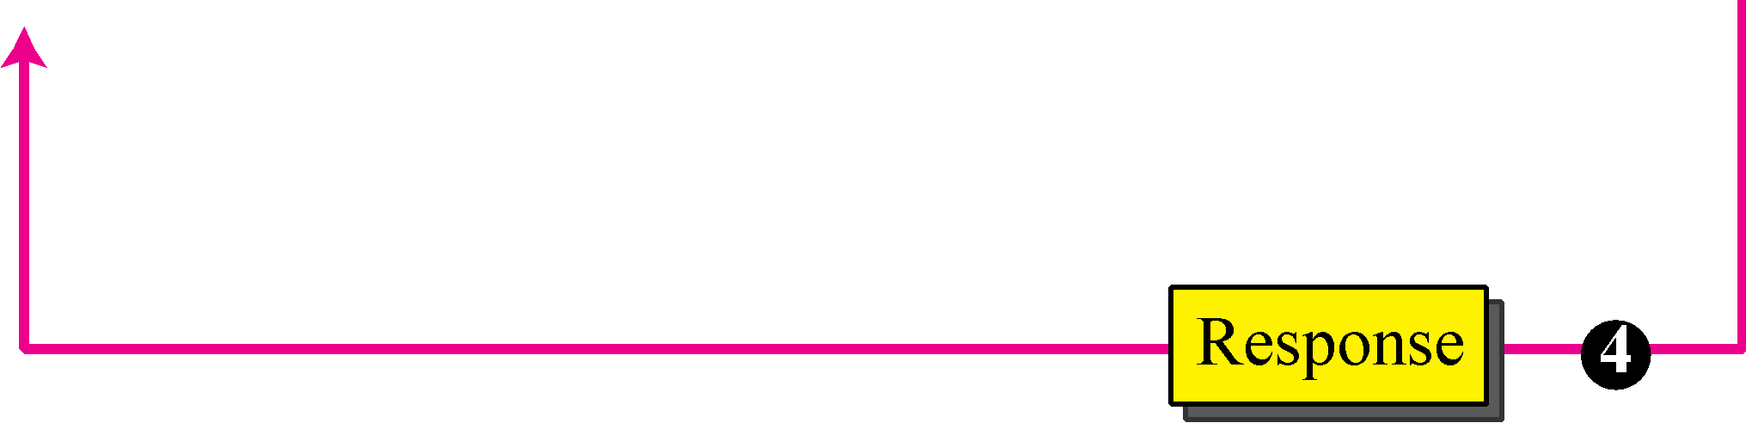
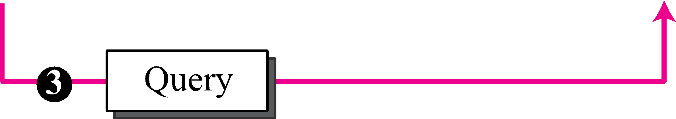
Figure 19.1 Purpose of DNS

Slide 17
NAME SPACE
Flat Name Space
Series of characters without any structure.
Cannot be used for large systems like internet.
Hierarchical Name Space
First part defines nature of organization
Second part defines name of organization
Third part defines department of organization and so on.

Slide 18
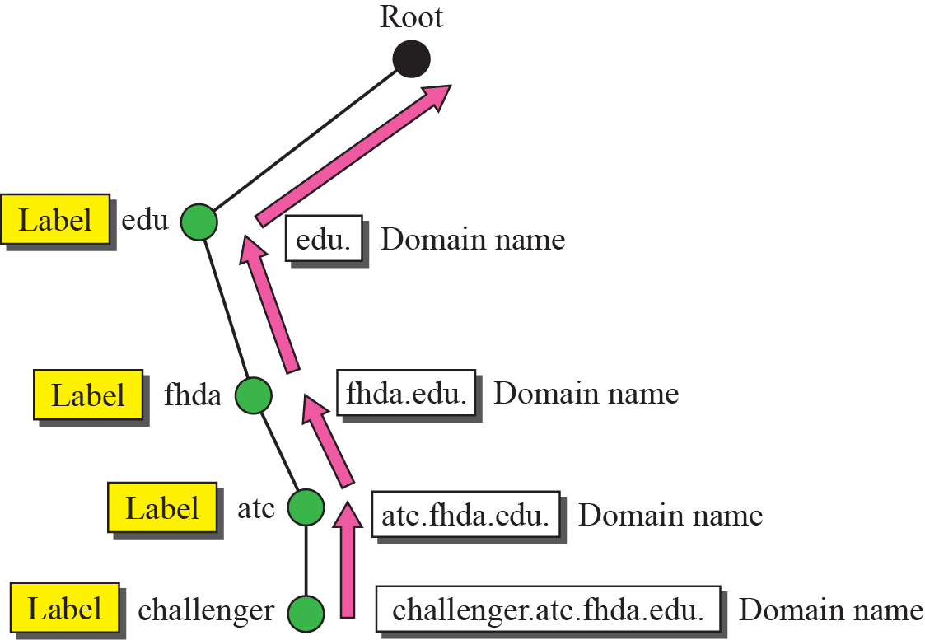
Domain names and labels

Slide 19
DNS IN THE INTERNET
DNS is a protocol that can be used in different platforms. In the Internet, the domain name space (tree) is divided into three different sections:
Generic domains
Country domains
Inverse domain

Slide 20
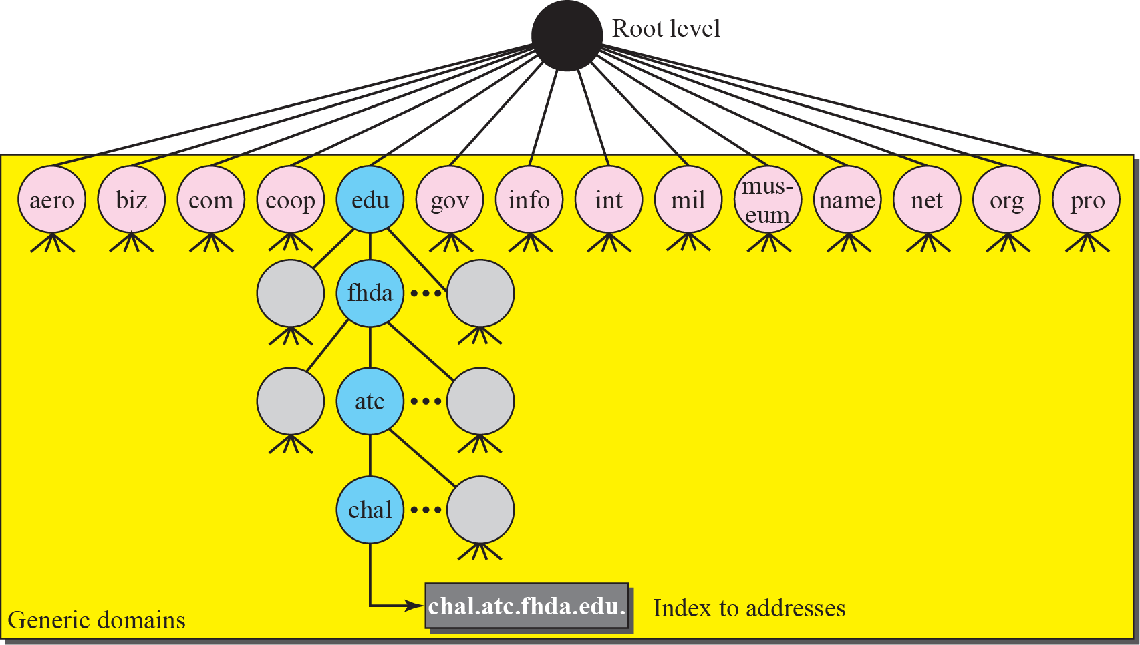
Generic domains

Slide 21
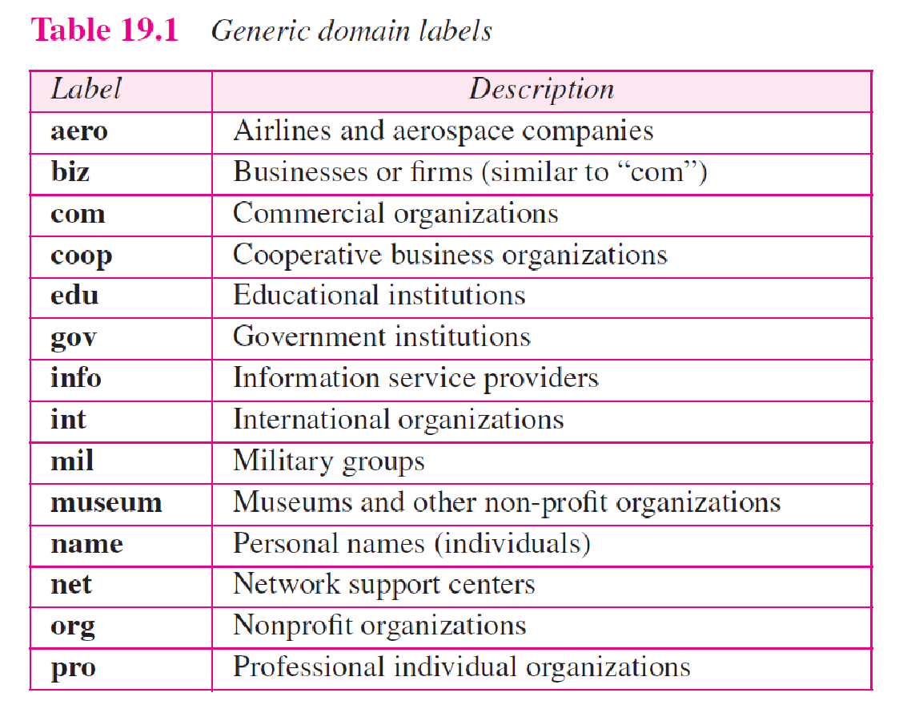

Slide 22
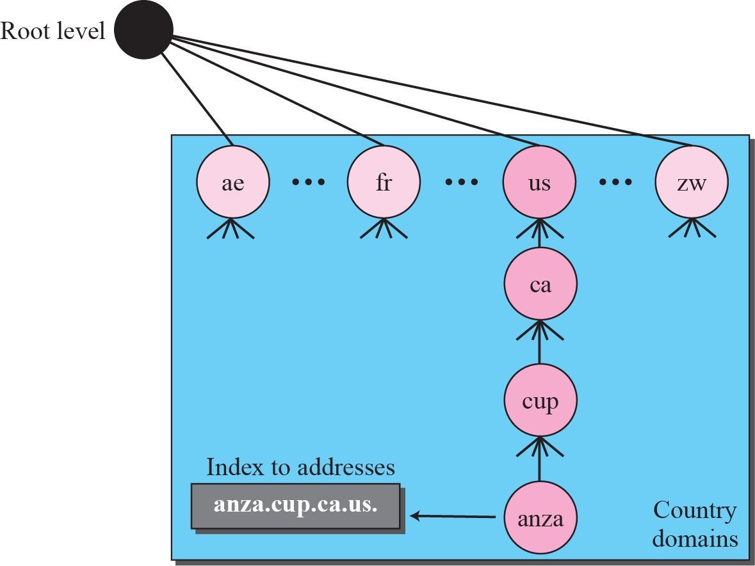
Country domains

Slide 23
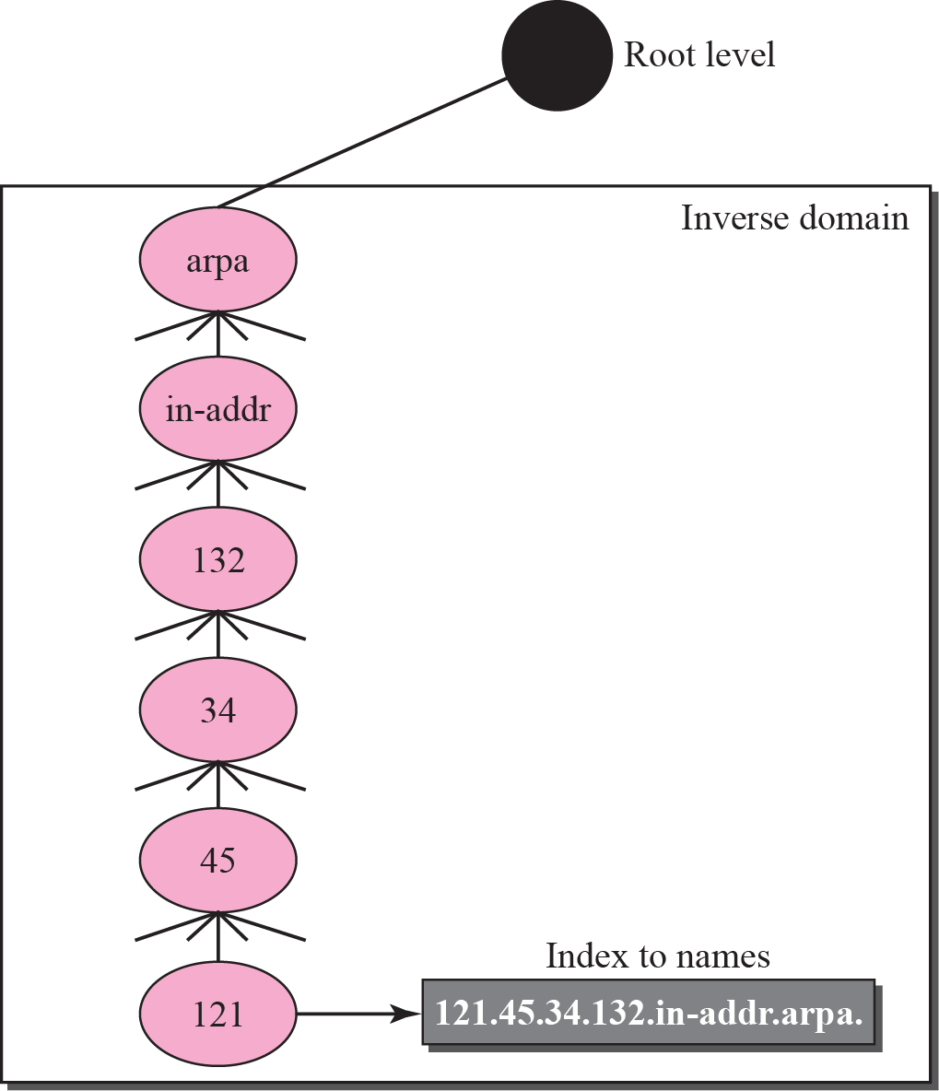
Inverse domain

Slide 24
DNS Messages
Query Messages
Response Messages

Slide 25
TELNET
TELNET is standard TCP/IP protocol that lets user access any application program on remote computer.
TELNET – Terminal Network
Standard protocol for virtual terminal service proposed by ISO.
TELNET enables establishment of connection to remote system such that local terminal appears to be terminal at remote system.
TELNET is a general-purpose client-server application program

Slide 26
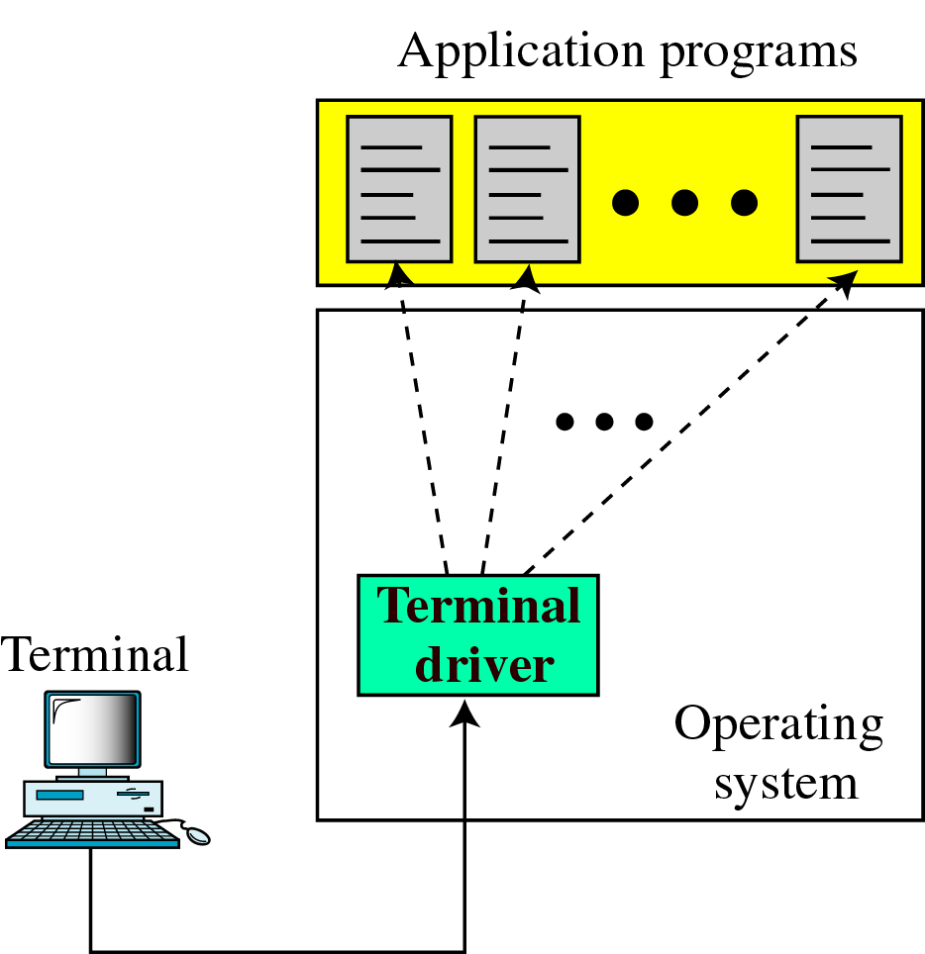
TELNET
Local Login

Slide 27
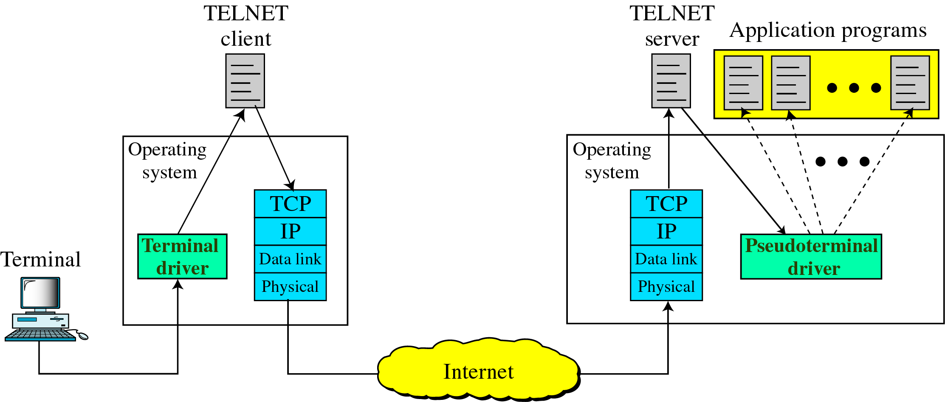
2.Remote Login

Slide 28
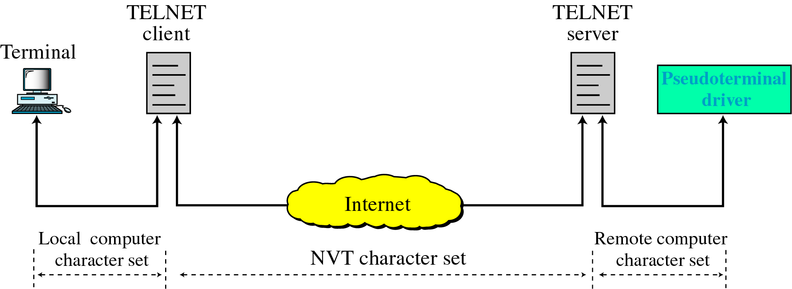
Concept of NVT

